Slide 1


Slide 2

The Internet & Web (pt 2)

Slide 3
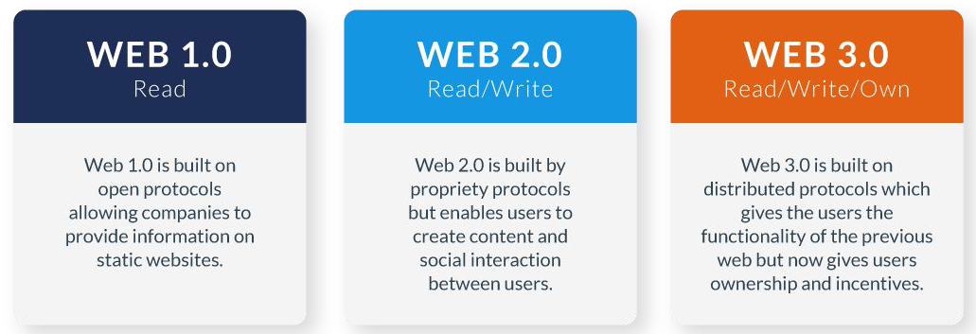

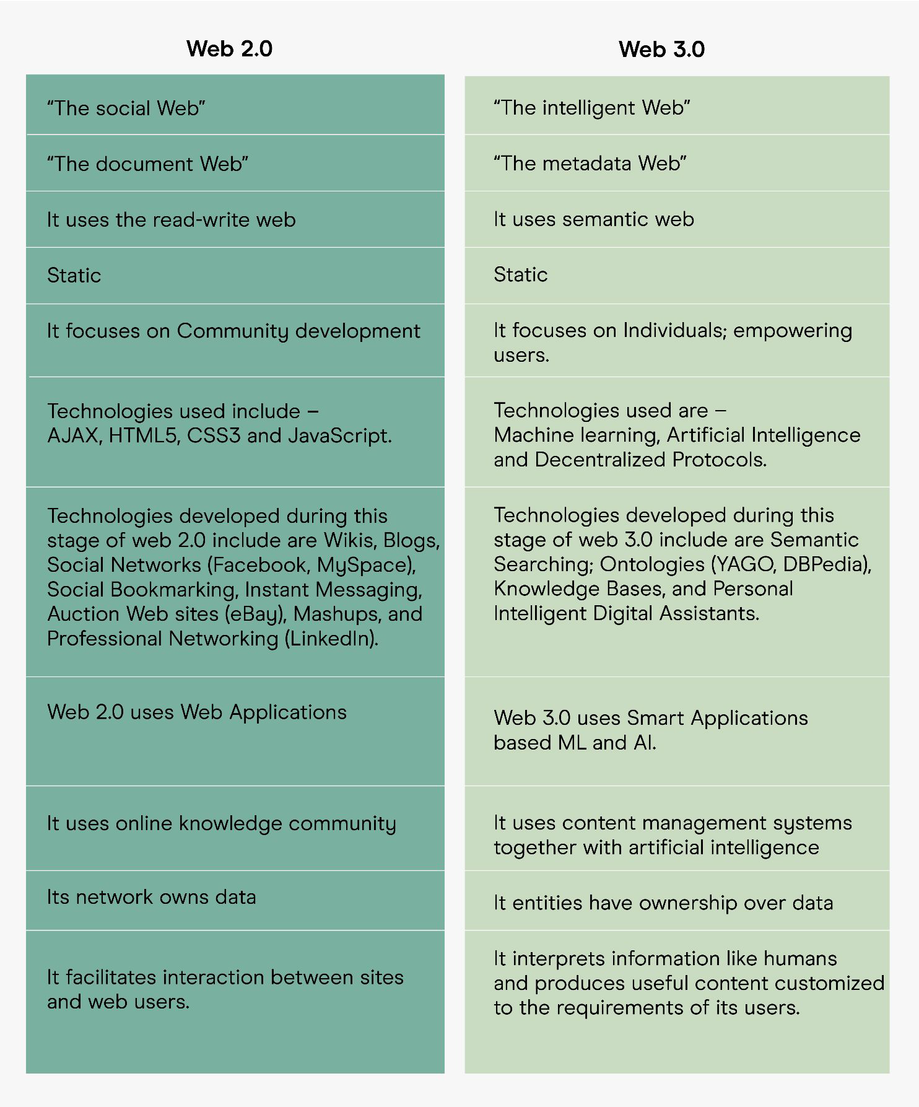

Web 1, Web 2 & Web 3.0
Overtime the web has naturally evolved becoming more complex and more structured. These evolutions are broadly set-out as Web 1.0 - 3.0.
Web 1.0
The “ﬁrst” version of the web, a stage where a minority created web pages for a large group of readers - often known as the read-only web. Primarily HTML and CSS only.
Web 2.0
This is partially where we are at today, many people creating content with the web built upon User-Generated Content (UGC). Generally more complex sites, known as Dynamic, utilising server side software and browser technologies such as JavaScript.
Web 3.0 aka. the Semantic Web
We are working our way through this now. Semantics makes web pages machine-readable, the core focus is a common framework of markup allowing web page content to be understood outside of it’s own domain.

Slide 4
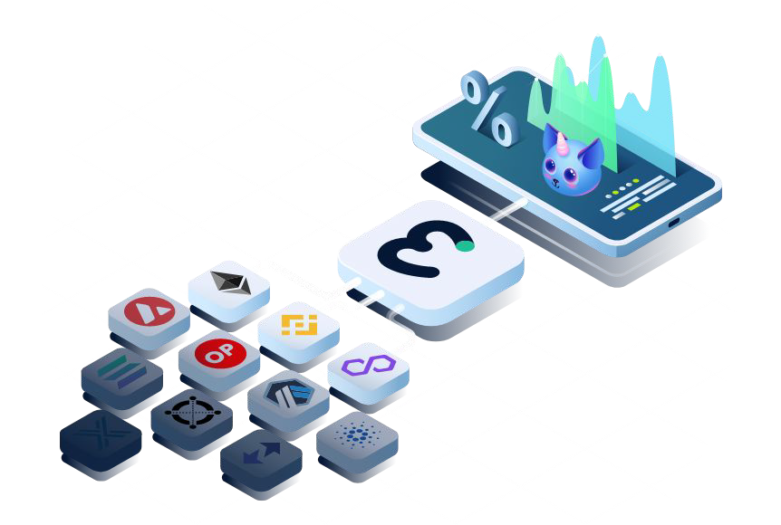
Web 3.0 & Web3
The concept of Web3 is a decentralised and open web based on blockchain technology. The fundamental idea behind web3 is to create a decentralized version of the Internet by removing the dominance of the centralized power of web 2.0 giants like Amazon and Facebook, giving the control back to users.
Web3 and decentralisation are major buzzwords right now, following on from the Blockchain hype a few years prior - however this doesn’t necessarily mean this is where we are heading.
Web 3.0 has never been fully realised, networks still own our data and do not share between each other - so there’s a long way to go still.
Maybe Web3 will have greater success however the technology is based from Blockchain and the success of that is still yet to be forthcoming.
Both approaches have the same noble goals of improving the web, returning control to users and increasing transparency, with differing approaches.

Slide 5
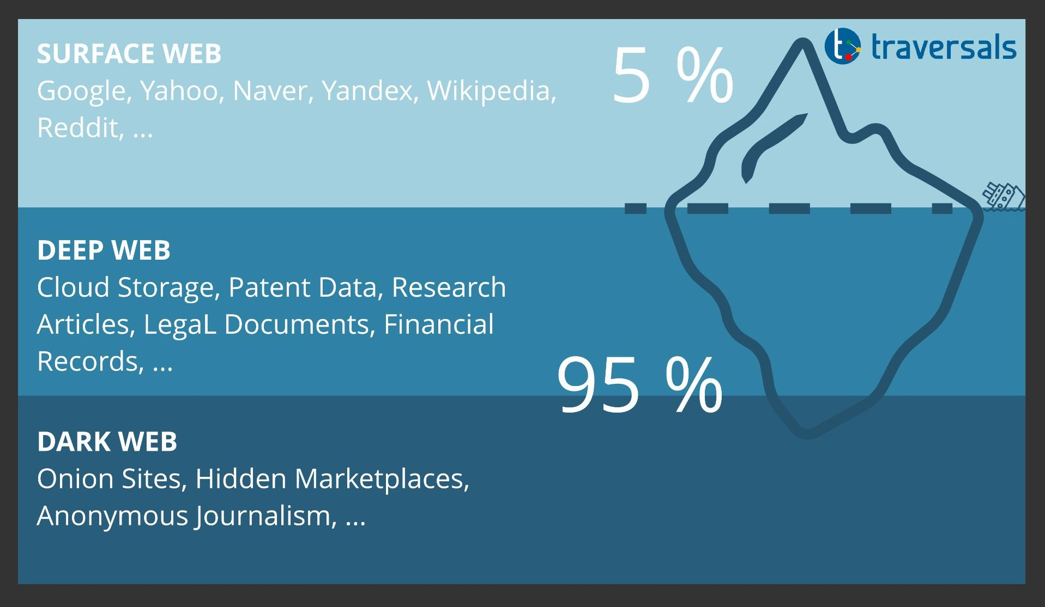
Deep & Dark Web
Think of the web having 3 layers, most of the content we access is within the top layer, the surface/visible web. This layer constitutes less than 5 % of the entire web.
Surface/Visible Web
Indexed content, this means it generally will show up in search engines such as Google.
Deep/Hidden Web
The part of the web that typical search engines cannot index. Usually due to password protected systems (i.e. Moodle content) and/or APIs and web services.
Dark Web (Darknet)
This is the anonymous web, it requires specialist software to access it such as Tor (Developed by the US Navy for spies). Primarily used for illegal activities or maintaining anonymity.

Slide 6
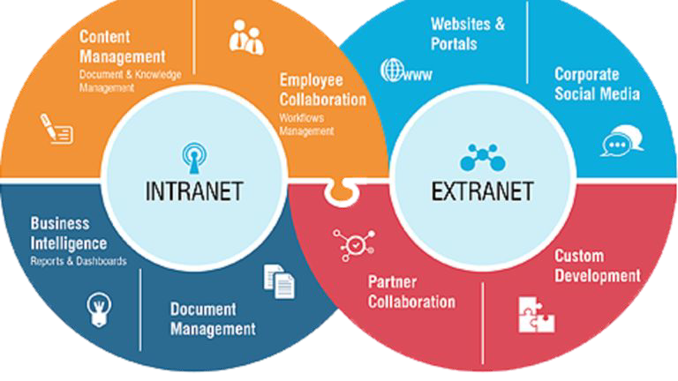
Intranet & Extranet
So far we have discussed the internet, there are also other types of network that utilise a similar infrastructure.
Intranet
Private networks that are restricted to members of a particular organization. They are commonly used to provide a portal for members to securely access shared resources, collaborate and communicate.
Extranet
An extranet permits controlled access to authorized external users to a company intranet. Essentially, extranets take the concept of an intranet to another level, allowing customers, vendors, partners, or selected third parties access to a company intranet, or designated areas of it. But it is not open to the general public

Slide 7
The Cloud

Slide 8
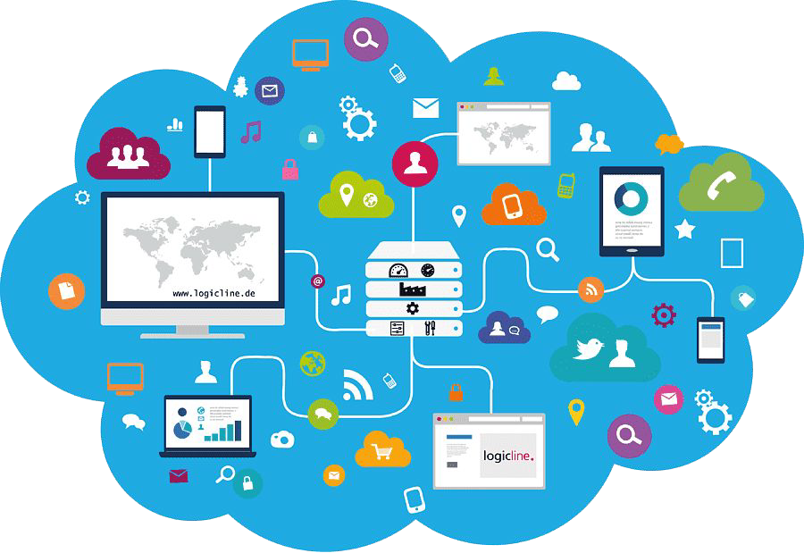
What is the Cloud?
Cloud computing is the on-demand availability of computing resources as services over the internet. It eliminates the need for enterprises to procure, conﬁgure, or manage resources themselves, and they only pay for what they use.
Cloud computing service models are based on the concept of sharing on-demand computing resources, software, and information over the internet.
Companies or individuals pay to access a virtual pool of shared resources, including computer, storage, and networking services, which are located on remote servers that are owned and managed by service providers.

Slide 9

On-premise
IT infrastructure hardware and software applications that are hosted on-site. This is a less common approach in modern times, however many legacy and traditional data center resources are still on-premises.
The beneﬁts are more direct control of the equipment, but with an initial server purchase and setup cost, software license fees, and ongoing server maintenance costs.
There are also security concerns in terms of protecting data from corruption and from illegal access/manipulation, sometimes this is a reason to utilise on-premise to ensure you have complete control over these elements.

Slide 10
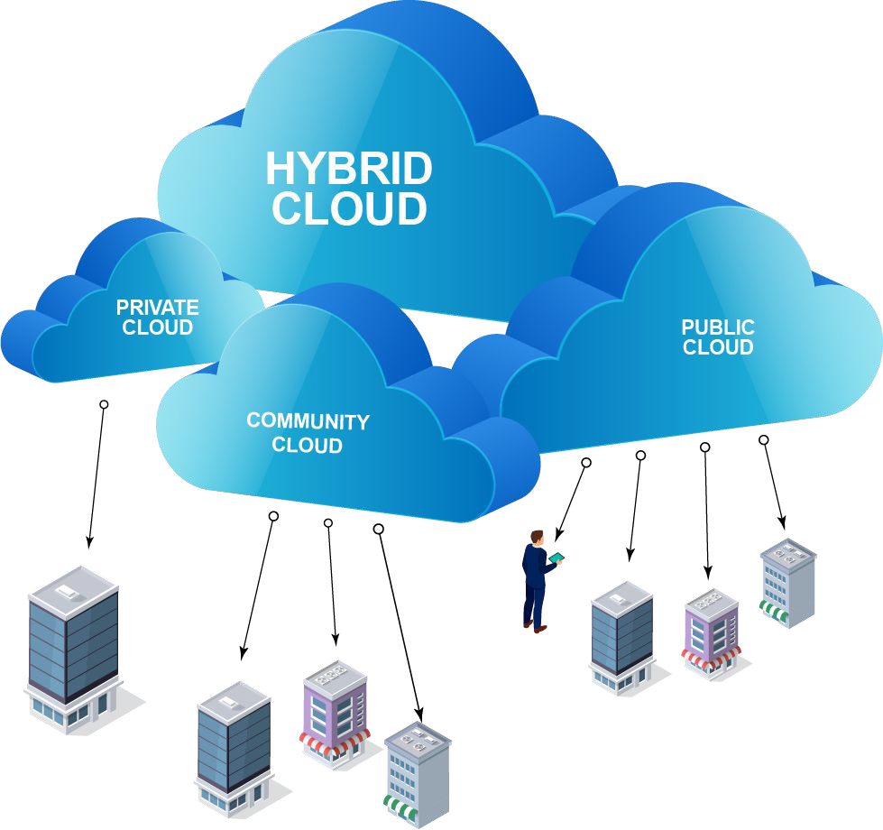
Cloud Deployment Types
There are four main types of cloud computing: private clouds, public clouds, hybrid clouds, and multiclouds. Every cloud abstracts, pools, and shares scalable computing resources across a network.
Public Cloud - typically created from IT infrastructure not owned by the end user.
Private Cloud - solely dedicated to a single end user or group.
Hybrid Cloud - applications are running in a combination of different environments.
Multiclouds - made up of more than 1 cloud service, from more than 1 cloud vendor.

Slide 11
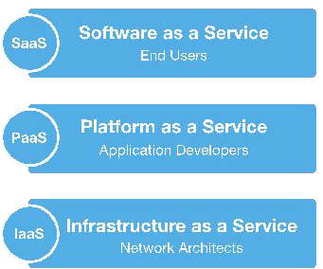
Cloud Service Models
There are three main types of cloud computing service models based on the level of control, ﬂexibility, and management the user needs:
Infrastructure as a Service (IaaS): on-demand access to IT infrastructure services, including compute, storage, networking, and virtualization.
Platform as a Service (PaaS): offers all the hardware and software resources needed for cloud application development.
Software as a Service (SaaS): delivers a full application stack as a service, from underlying infrastructure to maintenance and updates to the app software itself.

Slide 12
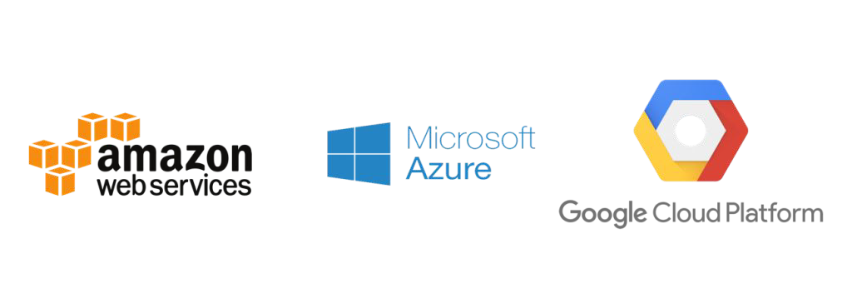
Cloud Providers
There are countless cloud service providers that are utilised across the world, depending on their needs and preferences.
Some providers, rather than operate their own hardware, simply resell and manage other providers services to make these simpler for use.
The most proliﬁc cloud providers on the market are:
Amazon Web Services (34%) - a dizzying array of services from storage to machine learning.
Microsoft Azure (21%) - tightly embedded within the MS ecosystem with a strong .NET utilisation.
Google Cloud Platform (11%) - a relatively new entry to the market without the range of functionality of AWS.

Slide 13
?

